Slide 1
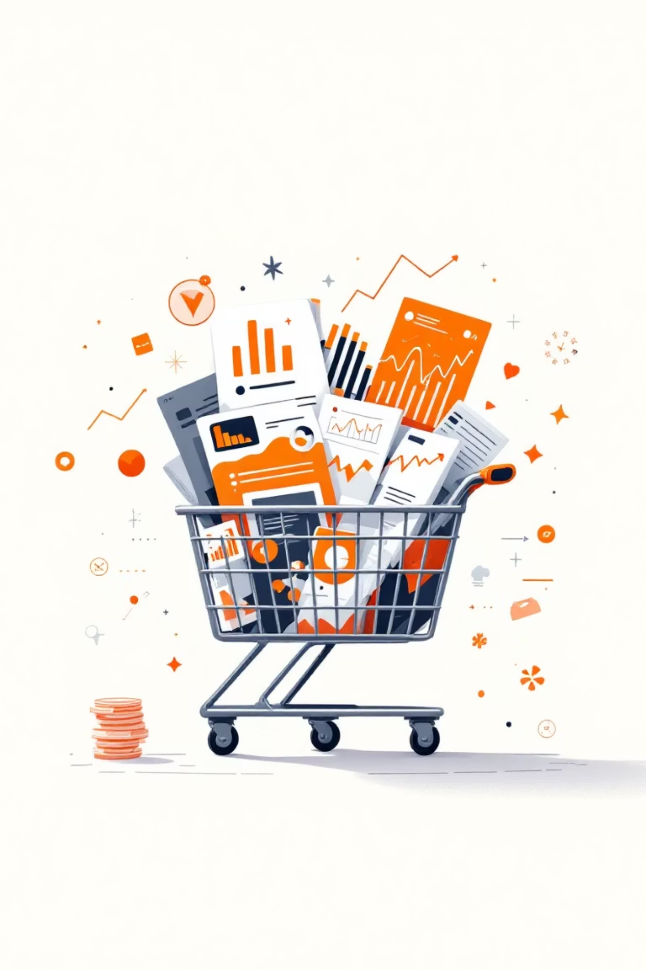
Customer Shopping Behavior Analysis
This project analyzes customer shopping behavior using transactional data to uncover insights into spending patterns, customer segments, product preferences, and subscription behavior. The goal is to guide strategic business decisions.

Slide 2


Project Overview & Dataset Summary
Project Goal
Dataset Details
Analyze 3,900 purchases to understand customer spending, segments, product preferences, and subscription behavior.
3,900 Rows, 18 Columns
Key Features: Demographics, Purchase Details, Shopping Behavior
Missing Data: 37 values in Review Rating

Slide 3

Exploratory Data Analysis with Python
Data Loading & Exploration
Imported dataset with pandas; checked structure and summary statistics.
Missing Data Handling
Imputed missing 'Review Rating' values using median rating per product category.
Feature Engineering
Created 'age_group' and 'purchase_frequency_days' for deeper analysis.
Database Integration
Loaded cleaned data into PostgreSQL for SQL analysis.

Slide 4

Key SQL Insights: Revenue & Discounts
Revenue by Gender
High-Spending Discount Users
Male customers generated significantly more revenue.
839 customers used discounts but spent above average.
Female
75191
Male
157890

Slide 5

SQL Insights: Product & Shipping
Top 5 Products by Rating
Shipping Type Comparison
Gloves: 3.86
Express shipping users have slightly higher average purchase amounts.
Sandals: 3.84
Boots: 3.82
Standard
58.46
Hat: 3.80
Express
60.48
Skirt: 3.78

Slide 6

SQL Insights: Subscription & Discounts
1
2
Subscribers vs. Non-Subscribers
Discount-Dependent Products
Non-subscribers have a slightly higher average spend and total revenue.
Hat (50%), Sneakers (49.66%), Coat (49.07%), Sweater (48.17%), Pants (47.37%) had highest discount rates.

Slide 7




SQL Insights: Customer Segmentation
New
83 Customers
Loyal
3116 Customers
Returning
701 Customers
Customers classified into segments based on purchase history.

Slide 8
SQL Insights: Product Categories & Age Groups
Top Products per Category
Revenue by Age Group
Accessories: Jewelry, Sunglasses, Belt
Young Adults contribute the most revenue, followed by Middle-aged.
Clothing: Blouse, Pants, Shirt
Footwear: Sandals, Shoes, Sneakers
Young Adult
62143
Outerwear: Jacket, Coat
Middle-aged
59197
Adult
55978
Senior
55763

Slide 9
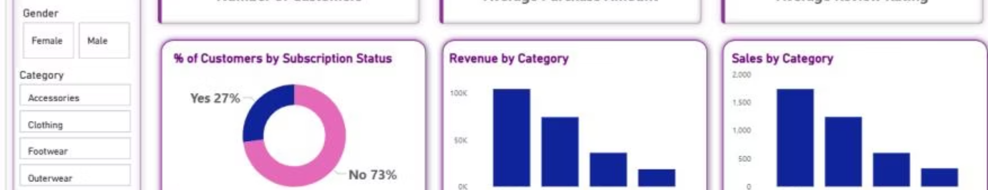
Interactive Power BI Dashboard
Visualized key insights with an interactive Power BI dashboard.
Key Metrics
Filters
Visualizations
3.9K Customers
Subscription Status, Gender, Category, Shipping Type
Subscription % (27% Yes, 73% No), Revenue/Sales by Category & Age Group
$59.76 Avg. Purchase
3.75 Avg. Review

Slide 10





Strategic Business Recommendations
Boost Subscriptions
Promote exclusive benefits to increase subscriber base.
Customer Loyalty
Implement programs to reward repeat buyers and foster loyalty.
Review Discount Policy
Balance sales boosts with maintaining healthy profit margins.
Product Positioning
Highlight top-rated and best-selling products in marketing campaigns.
Targeted Marketing
Focus efforts on high-revenue age groups and express-shipping users.

